Slide 1
English 7-Chapter 8
Revising Wordy Sentences
Exercise 10

Slide 3
1.
1. Our science class has been learning about the starfish, which is a strange and beautiful animal.
Wordy
Our science class has been learning about the starfish, a strange and beautiful animal.

Slide 4
2
What I want to say is that starfish are fascinating creatures.
Wordy
Starfish are fascinating creatures.

Slide 5
3
A starfish has little feet tipped with suction cups that have suction power.
Wordy
A starfish has little feet tipped with suction cups.

Slide 6
4
At the end of each arm is a sensitive eyespot.
Correct

Slide 7
5
In spite of the fact that the eyespot cannot really see things, it can tell light from dark.
Wordy
Though the eyespot cannot really see things, it can tell light from dark.

Slide 8
6
The starfish’s mouth is in the middle of its body.
Correct

Slide 9
7
When it uses its arms, it can pull at the shells of clams.
Wordy
Using its arms, it can pull at the shells of clams.

Slide 10
8
At the point at which the clam’s shell opens, the starfish can feed on the clam.
Wordy
When the clam’s shell opens, the starfish can feed on the clam.

Slide 11
9
Starfish come in a variety of colors, shapes, and sizes, and some are bigger than others.
Wordy
Starfish come in a variety of colors, shapes, and sizes.

Slide 12
10
This photograph shows a blue sea star holding onto a soft coral by holding it with its suction cups.
Wordy
This photograph shows a blue sea star holding onto a soft coral with its suction cups.

Slide 13
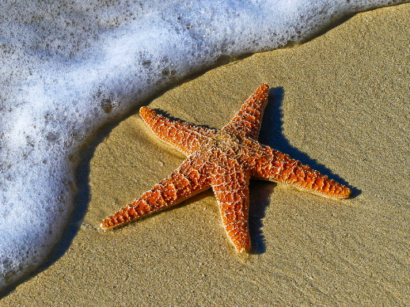
The End!

